Slide 1
An Introduction to Description Logics

Slide 2
What Are Description Logics?
A family of logic based Knowledge Representation formalisms
  Descendants of semantic networks and KL-ONE
  Describe domain in terms of concepts (classes), roles (relationships) and individuals
Distinguished by:
  Formal semantics (typically model theoretic)
    Decidable fragments of FOL
    Closely related to Propositional Modal & Dynamic Logics
  Provision of inference services
    Sound and complete decision procedures for key problems
    Implemented systems (highly optimised)

Slide 3
DL Architecture
Knowledge Base
Tbox (schema)
Man ´ Human u Male
Happy-Father ´ Man u 9 has-child Female u …
Interface
Inference System
Abox (data)
John : Happy-Father
hJohn, Maryi : has-child

Slide 4
Short History of Description Logics
Phase 1:
  Incomplete systems (Back, Classic, Loom, . . . )
  Based on structural algorithms
Phase 2:
  Development of tableau algorithms and complexity results
  Tableau-based systems for Pspace logics (e.g., Kris, Crack)
  Investigation of optimisation techniques
Phase 3:
  Tableau algorithms for very expressive DLs
  Highly optimised tableau systems for ExpTime logics (e.g., FaCT, DLP, Racer)
  Relationship to modal logic and decidable fragments of FOL

Slide 5
Latest Developments
Phase 4:
  Mature implementations
  Mainstream applications and Tools
    Databases
      Consistency of conceptual schemata (EER, UML etc.)
      Schema integration
      Query subsumption (w.r.t. a conceptual schema)
    Ontologies and Semantic Web (and Grid)
      Ontology engineering (design, maintenance, integration)
      Reasoning with ontology-based markup (meta-data)
      Service description and discovery
  Commercial implementations
    Cerebra system from Network Inference Ltd

Slide 6
Description Logic Family
DLs are a family of logic based KR formalisms
Particular languages mainly characterised by:
  Set of constructors for building complex concepts and roles from simpler ones
  Set of axioms for asserting facts about concepts, roles and individuals
ALC is the smallest DL that is propositionally closed
  Constructors include booleans (and, or, not), and
  Restrictions on role successors
  E.g., concept describing “happy fathers” could be written:
    Man ⬆ ∃hasChild.Female ⬆ ∃hasChild.Male
     ∀hasChild.(Rich  Happy)

Slide 7
DL Concept and Role Constructors
Range of other constructors found in DLs, including:
  Number restrictions (cardinality constraints) on roles, e.g., 3 hasChild, 1 hasMother
  Qualified number restrictions, e.g., 2 hasChild.Female, 1 hasParent.Male
  Nominals (singleton concepts), e.g., {Italy}
  Concrete domains (datatypes), e.g., hasAge.(21), earns spends.<
  Inverse roles, e.g., hasChild⁻ (hasParent)
  Transitive roles, e.g., hasChild* (descendant)
  Role composition, e.g., hasParent o hasBrother (uncle)

Slide 8
DL Knowledge Base
DL Knowledge Base (KB) normally separated into 2 parts:
  TBox is a set of axioms describing structure of domain (i.e., a conceptual schema), e.g.:
    HappyFather ≡ Man ⬆ ∃hasChild.Female ⬆ …
    Elephant  Animal ⬆ Large ⬆ Grey
    transitive(ancestor)
  ABox is a set of axioms describing a concrete situation (data), e.g.:
    John:HappyFather
    <John,Mary>:hasChild
Separation has no logical significance
  But may be conceptually and implementationally convenient

Slide 9
OWL as DL: Class Constructors
XMLS datatypes as well as classes in 8P.C and 9P.C
  E.g., 9hasAge.nonNegativeInteger
Arbitrarily complex nesting of constructors
  E.g., Person u 8hasChild.(Doctor t 9hasChild.Doctor)

Slide 10
RDFS Syntax
<owl:Class>
<owl:intersectionOf rdf:parseType=" collection">
<owl:Class rdf:about="#Person"/>
<owl:Restriction>
<owl:onProperty rdf:resource="#hasChild"/>
<owl:toClass>
<owl:unionOf rdf:parseType=" collection">
<owl:Class rdf:about="#Doctor"/>
<owl:Restriction>
<owl:onProperty rdf:resource="#hasChild"/>
<owl:hasClass rdf:resource="#Doctor"/>
</owl:Restriction>
</owl:unionOf>
</owl:toClass>
</owl:Restriction>
</owl:intersectionOf>
</owl:Class>
E.g., Person u 8hasChild.(Doctor t 9hasChild.Doctor):

Slide 11
OWL as DL: Axioms
Axioms (mostly) reducible to inclusion (v)
  C ´ D iff both C v D and D v C
Obvious FOL equivalences
  E.g., C ´ D  ∀x.C(x)  D(x), C v D  ∀x.C(x)  D(x)

Slide 12
XML Schema Datatypes in OWL
OWL supports XML Schema primitive datatypes
  E.g., integer, real, string, …
Strict separation between “object” classes and datatypes
  Disjoint interpretation domain Δ_{D} for datatypes
    For a datavalue d, d^{I} µ Δ_{D}
    And Δ_{D} Å Δ^{I} = ;
  Disjoint “object” and datatype properties
    For a datatype propterty P, P^{I} µ Δ^{I} £ Δ_{D}
    For object property S and datatype property P, S^{I} Å P^{I} = ;
Equivalent to the “(D_{n})” in SHOIN(D_{n})

Slide 13
Why Separate Classes and Datatypes?
Philosophical reasons:
  Datatypes structured by built-in predicates
  Not appropriate to form new datatypes using ontology language
Practical reasons:
  Ontology language remains simple and compact
  Semantic integrity of ontology language not compromised
  Implementability not compromised — can use hybrid reasoner
    Only need sound and complete decision procedure for:
    d^{I}₁ Å … Å d^{I}_{n}, where d is a (possibly negated) datatype

Slide 14
OWL DL Semantics
Mapping OWL to equivalent DL (SHOIN(D_{n})):
  Facilitates provision of reasoning services (using DL systems)
  Provides well defined semantics
DL semantics defined by interpretations: I = (Δ^{I}, ¢^{I}), where
  Δ^{I} is the domain (a non-empty set)
  ¢^{I} is an interpretation function that maps:
    Concept (class) name A ! subset A^{I} of Δ^{I}
    Role (property) name R ! binary relation R^{I} over Δ^{I}
    Individual name i ! i^{I} element of Δ^{I}

Slide 15
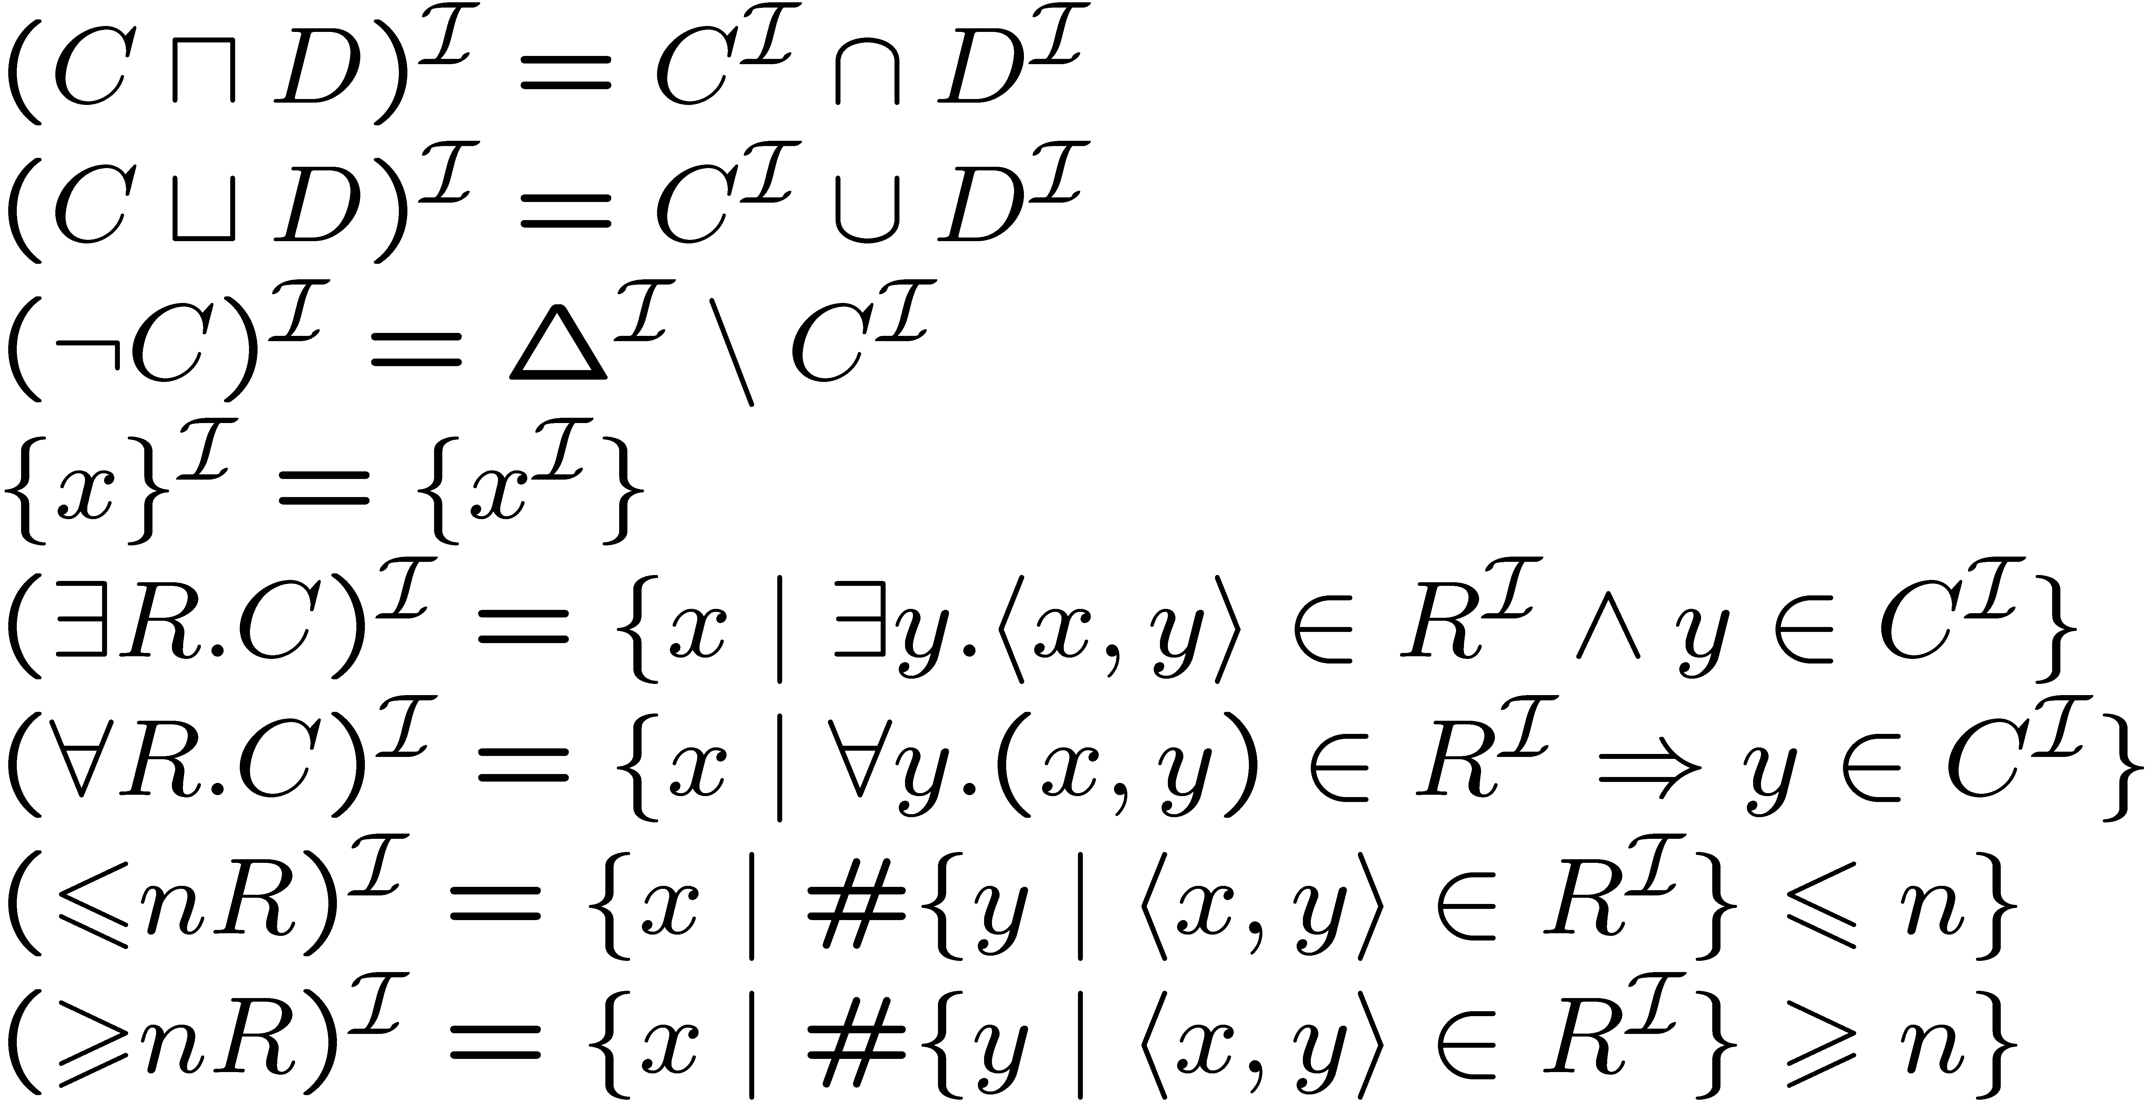
DL Semantics
Interpretation function ¢^{I} extends to concept expressions in the obvious way, i.e.:

Slide 16
Interpretation Example
Δ = {v, w, x, y, z}
A^{I} = {v, w, x}
B^{I} = {x, y}
R^{I} = {(v, w), (v, x), (y, x), (x, z)}
: B =
A u B =
: A t B =
9 R B =
8 R B =
9 R (9 R A) =
9 R : (A t B) =
6 1 R A =
> 1 R A =
A^{I}
v
w
x
y
z
B^{I}

Slide 17
DL Knowledge Bases (Ontologies)
An OWL ontology maps to a DL Knowledge Base K = hT , Ai
  T (Tbox) is a set of axioms of the form:
    C v D (concept inclusion)
    C ´ D (concept equivalence)
    R v S (role inclusion)
    R ´ S (role equivalence)
    R⁺ v R (role transitivity)
  A (Abox) is a set of axioms of the form
    x 2 D (concept instantiation)
    hx,yi 2 R (role instantiation)
Two sorts of Tbox axioms often distinguished
  “Definitions”
    C v D or C ´ D where C is a concept name
  General Concept Inclusion axioms (GCIs)
    C v D where C in an arbitrary concept

Slide 18
Knowledge Base Semantics
An interpretation I satisfies (models) an axiom A (I ² A):
  I ² C v D iff C^{I} µ D^{I}
  I ² C ´ D iff C^{I} = D^{I}
  I ² R v S iff R^{I} µ S^{I}
  I ² R ´ S iff R^{I} = S^{I}
  I ² R⁺ v R iff (R^{I})⁺ µ R^{I}
  I ² x 2 D iff x^{I} 2 D^{I}
  I ² hx,yi 2 R iff (x^{I},y^{I}) 2 R^{I}
I satisfies a Tbox T (I ² T ) iff I satisfies every axiom A in T
I satisfies an Abox A (I ² A) iff I satisfies every axiom A in A
I satisfies an KB K (I ² K) iff I satisfies both T and A

Slide 19
Multiple Models -v- Single Model
DL KB doesn’t define a single model, it is a set of constraints that define a set of possible models
  No constraints (empty KB) means any model is possible
  More constraints means fewer models
  Too many constraints may mean no possible model (inconsistent KB)
In contrast, DBs (and frame/rule KR systems) make assumptions such that DB/KB defines a single model
  Unique name assumption
    Different names always interpreted as different individuals
  Closed world assumption
    Domain consists only of individuals named in the DB/KB
  Minimal models
    Extensions are as small as possible

Slide 20
Example of Multiple Models
KB = {}
KB = {a:C, b:D, c:C, d:E}
KB = {a:C, b:D, c:C, d:E, b:C}
KB = {a:C, b:D, c:C, d:E, b:C
D v C}
KB = {a:C, b:D, c:C, d:E, b:C
D v C, E v C}
KB = {a:C, b:D, c:C, d:E, b:C
D v C, E v C, d:: C}
I₁:
Δ = {v, w, x, y, z}
C^{I} = {v, w, y}
D^{I} = {x, y} E^{I} = {z}
a^{I} = v b^{I} = x
c^{I} = w d^{I} = y
I₃:
Δ = {v, w, x, y, z}
C^{I} = {v, w, y}
D^{I} = {x, y} E^{I} = {z}
a^{I} = v b^{I} = y
c^{I} = w d^{I} = z
I₂:
Δ = {v, w, x, y, z}
C^{I} = {v, w, y}
D^{I} = {x, y} E^{I} = {z}
a^{I} = v b^{I} = x
c^{I} = w d^{I} = z
I₄:
Δ = {v, w, x, y, z}
C^{I} = {v, w, x, y}
D^{I} = {x, y} E^{I} = {z}
a^{I} = v b^{I} = x
c^{I} = y d^{I} = y

Slide 21
Example of Single Model
KB = {}
KB = {a:C, b:D, c:C, d:E}
KB = {a:C, b:D, c:C, d:E, b:C}
KB = {a:C, b:D, c:C, d:E, b:C
E v C}
I:
Δ = {}
I:
Δ = {a, b, c, d}
C^{I} = {a, b, c}
D^{I} = {b} E^{I} = {d}
a^{I} = a b^{I} = b
c^{I} = c d^{I} = d
I:
Δ = {a, b, c, d}
C^{I} = {a, c}
D^{I} = {b} E^{I} = {d}
a^{I} = a b^{I} = b
c^{I} = c d^{I} = d
I:
Δ = {a, b, c, d}
C^{I} = {a, b, c, d}
D^{I} = {b} E^{I} = {d}
a^{I} = a b^{I} = b
c^{I} = c d^{I} = d

Slide 22
Inference Tasks
Knowledge is correct (captures intuitions)
  C subsumes D w.r.t. K iff for every model I of K, C^{I} µ D^{I}
Knowledge is minimally redundant (no unintended synonyms)
  C is equivallent to D w.r.t. K iff for every model I of K, C^{I} = D^{I}
Knowledge is meaningful (classes can have instances)
  C is satisfiable w.r.t. K iff there exists some model I of K s.t. C^{I} ≠ ;
Querying knowledge
  x is an instance of C w.r.t. K iff for every model I of K, x^{I} 2 C^{I}
  hx,yi is an instance of R w.r.t. K iff for, every model I of K, (x^{I},y^{I}) 2 R^{I}
Knowledge base consistency
  A KB K is consistent iff there exists some model I of K

Slide 23
Single Model -v- Multiple Model
Multiple models:
Expressively powerful
  Boolean connectives, including : and t
Can capture incomplete information
  E.g., using t and 9
Monotonic
  Adding information preserves truth
Reasoning (e.g., querying) is hard/slow
Queries may give counter-intuitive results in some cases
Single model:
Expressively weaker (in most respects)
  No negation or disjunction
Can’t capture incomplete information
Nonmonotonic
  Adding information does not preserve truth
Reasoning (e.g., querying) is easy/fast
Queries may give counter-intuitive results in some cases

